Slide 1
Price Forecasting
Jack Morris

Slide 2

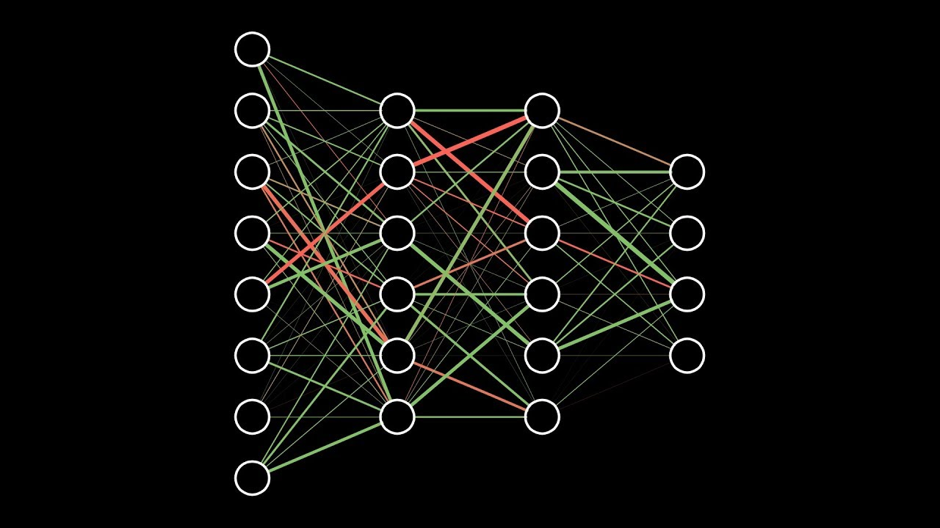
Neural Networks
Feed Forward (Dense)
Recurrent
Long Short-Term Memory

Slide 3
Network Architecture
INPUT
Up to 53 variables
Loss and Congestion
TESLA load forecast
24 hourly dummies
4 calendar variables
11 energy mix variables
7 reserves variables
LMP one and two hours back
LMP one and two days back
All data preprocessed
OUTPUT
LMP at the given hour for the given load zone
HIDDEN LAYERS
Conditional function adjusting hidden layer sizes given input size
Up to two hidden layers

Slide 4
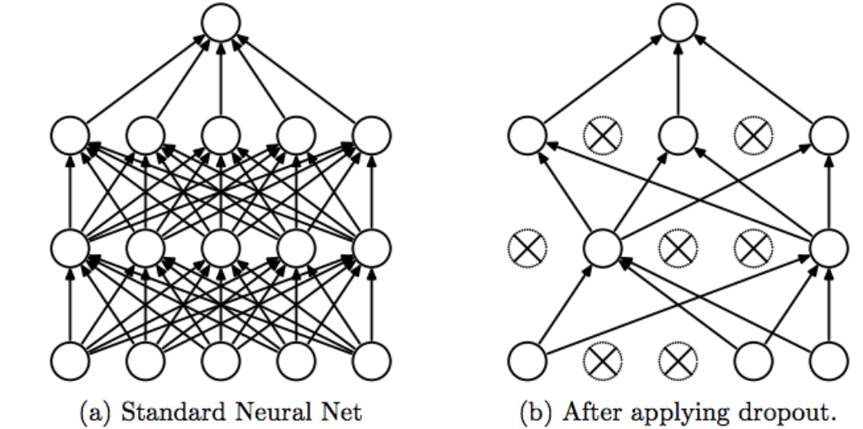
Parameters
Model Types
Dense
Recurrent
LSTM
Ensemble
Epochs <- 50
Batch Size <- 20
Dropout Rate <- 0.25
- Grid Search
Load Zones
PJM-RTO
Mid-Atlantic
Dominion
Hourly
Test Dates
June 24-30
December 10-16

Slide 5
KERAS
Marginal Cost of Losses
LMP
Marginal Cost of Congestion
def feed_forward_nn():
model = Sequential()
model.add(Dense(3, input_shape=(1, 2), kernel_initializer='glorot_uniform', activation='relu'))
model.add(Dense(1, input_shape=(1, 3), kernel_initializer='glorot_uniform', activation='relu'))
model.compile(loss='mean_squared_error', optimizer='adam')
estimator = KerasRegressor(build_fn=feed_forward_nn, epochs=50, batch_size=20)
estimator.fit(X_train, Y_train, validation_split=0.1)
yHat = estimator.predict(X_test)

Slide 6
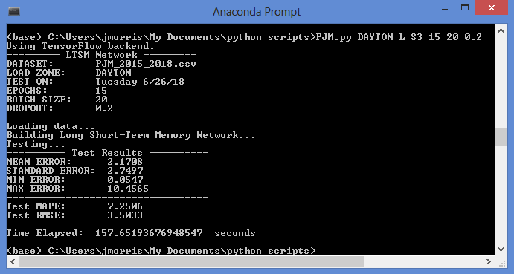
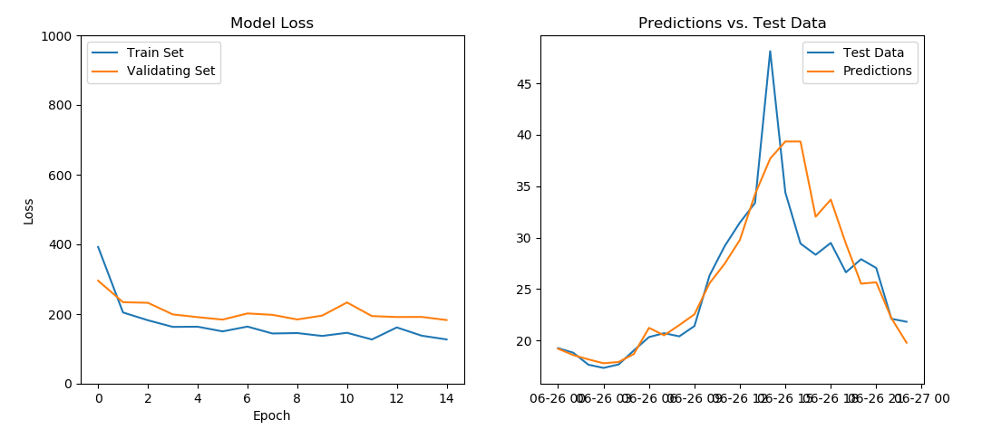
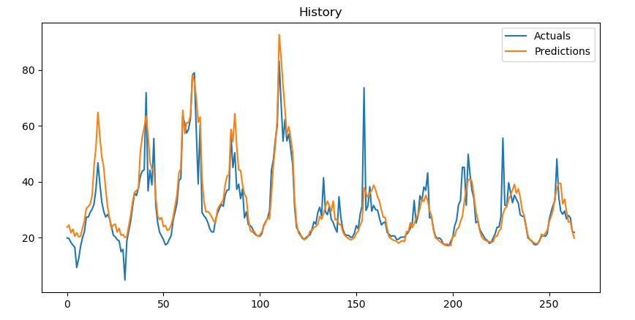
Prompt
PJM.py [Load Zone] [Model Type] [Test Day] [Epochs] [Batch Size] [Dropout Rate]
DOMINION R S5 50 20 0.25

Slide 7
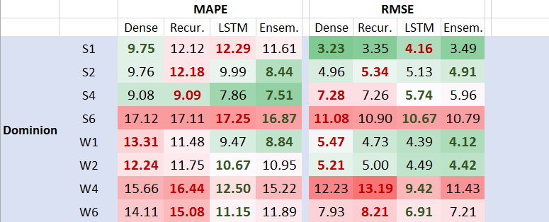
Dominion

Slide 8
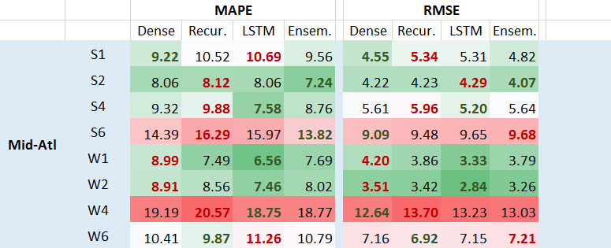
MID-ATL

Slide 9
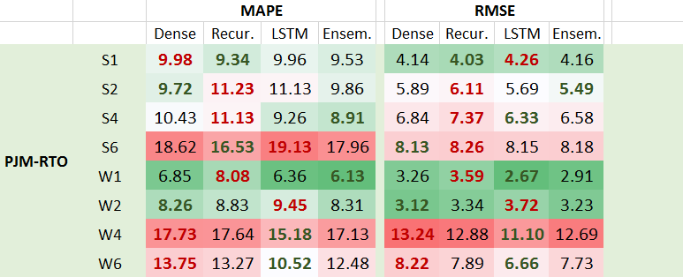
PJM-RTO

Slide 10
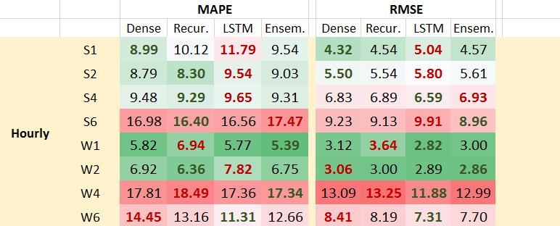
HOURLY

Slide 11
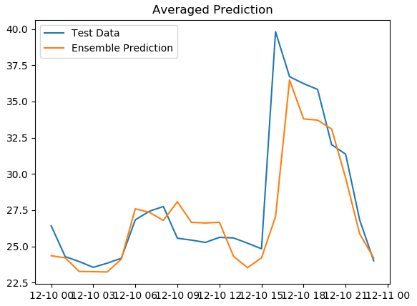
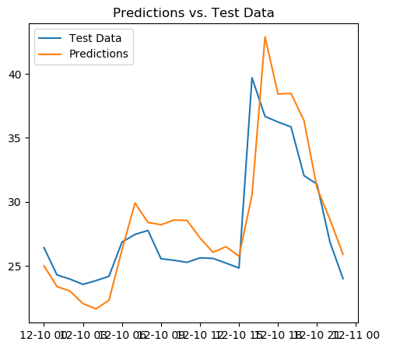
Best MAPE
Best RMSE
Ensemble, Hourly, W1
MAPE: 5.39
LSTM, PJM-RTO, W1
RMSE: 2.67

Slide 12
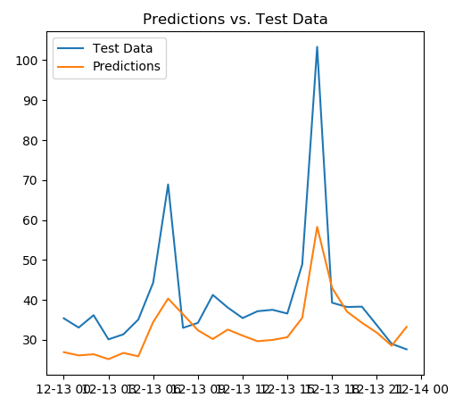
WORSt MAPE and RMSE
Recurrent, Mid-Atl, W4
MAPE: 20.57 RMSE: 13.7

Slide 13
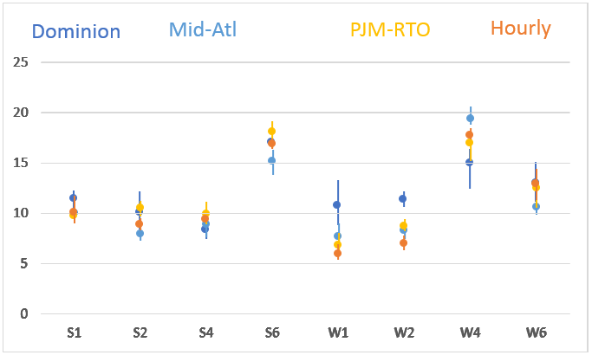
Load Zone Comparison

Slide 14
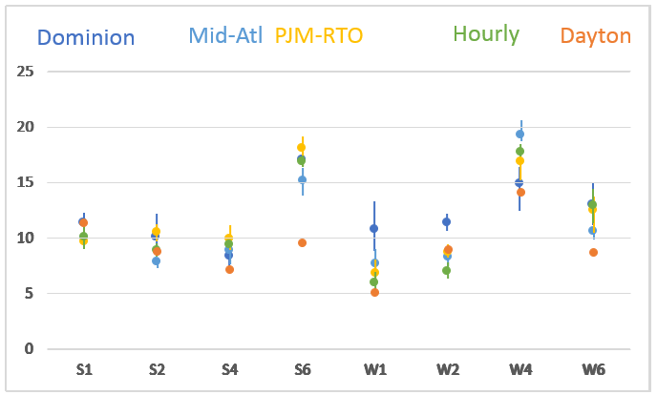
Dayton
New Lowest MAPE:
5.00
New Lowest RMSE:
2.09

Slide 15
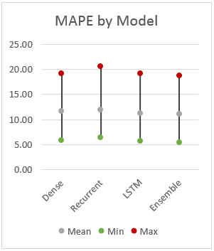
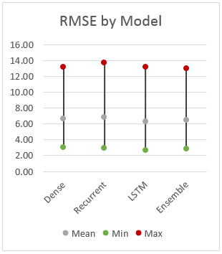
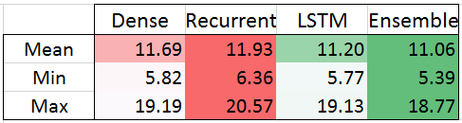
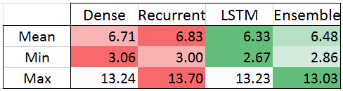

Slide 16
With more time...
Regression Models
Better Ensemble aggregation
Different/More/Better Data
Visualization
Grid Search from Prompt
File system for different models
Grid Search memory
Variable Selection
Past MAPEs
Ensemble Weights
Optimization
Network Architecture
Number of hidden layers
Hidden Layer sizes
Grid Search
Epochs, Batch Sizes, Dropout Rates
Variable Selection
Optimizers and loss functions
Initializers and activation functions
Early Stopping and Regularization

